Slide 1
Show me all your Passwords
Walter Legowski
Notes:
This is the slide shown before the presentation starts. When you are ready to go, tell the video operator to start the recording, and click to the next slide.

Slide 2
5
Video operator, did you start the recording?
Notes:
[REQUIRED SLIDE]
These slides are mandatory and help us with video post-processing. Please keep them as they are.

Slide 3
4
Notes:
[REQUIRED SLIDE]

Slide 4
3
Notes:
[REQUIRED SLIDE]

Slide 5
2
Notes:
[REQUIRED SLIDE]

Slide 6
1
Notes:
[REQUIRED SLIDE]

Slide 7
Show me all your Passwords
Walter Legowski
Notes:
This is your opening. Now the stage is yours!

Slide 8
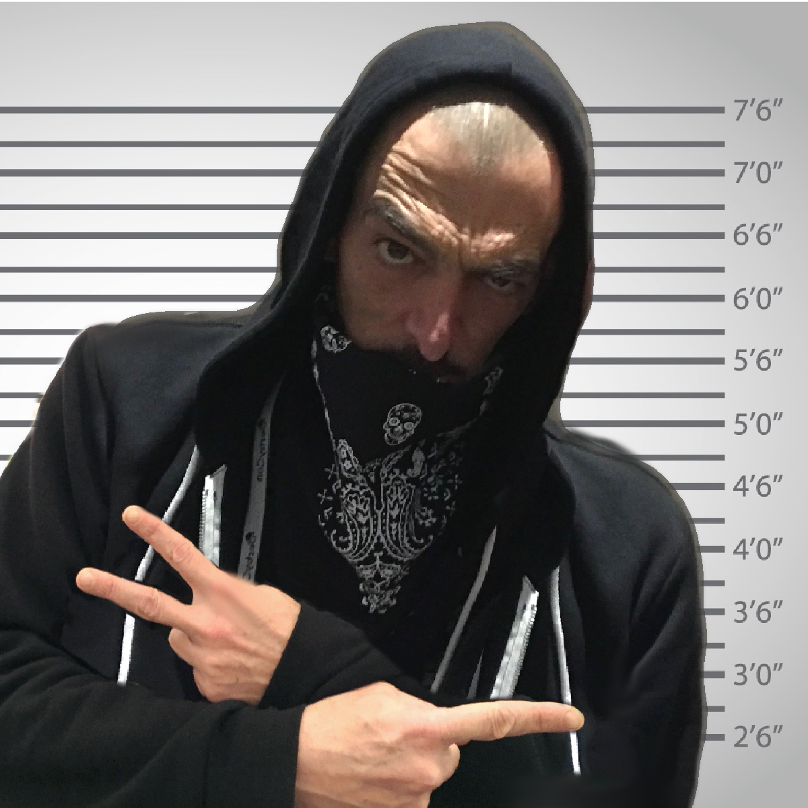
Whois
Walter Legowski @SadProcessor
Security Consultant @ ERNW [Troopers]
Born FR / Home NL / Work DE
Likes Cats / Lego / Memes
Security / Automation / Windows
PowerShell Bad Boy
Notes:
Please invest some time to reconsider your session: what is it that audience can get out of it? Try and be as precise as you can. If you are showing solutions, then focus on “how to”. If you present about a general technology, you’ll want to stick to “Be able to” or “Understand why/how”.

Slide 9
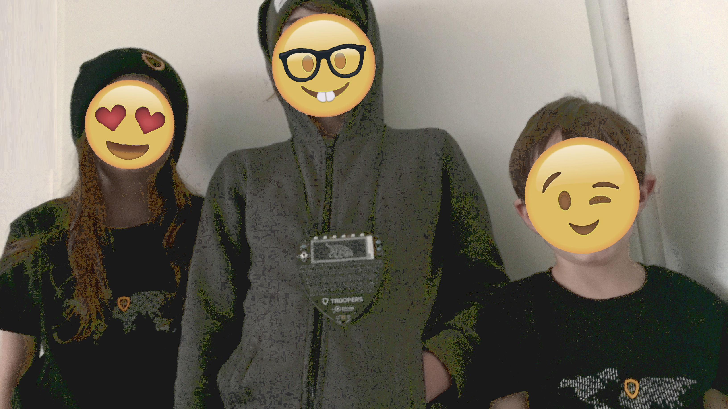
BigUp
NextGen Bad Boyz & Gal
Notes:
Please invest some time to reconsider your session: what is it that audience can get out of it? Try and be as precise as you can. If you are showing solutions, then focus on “how to”. If you present about a general technology, you’ll want to stick to “Be able to” or “Understand why/how”.

Slide 10
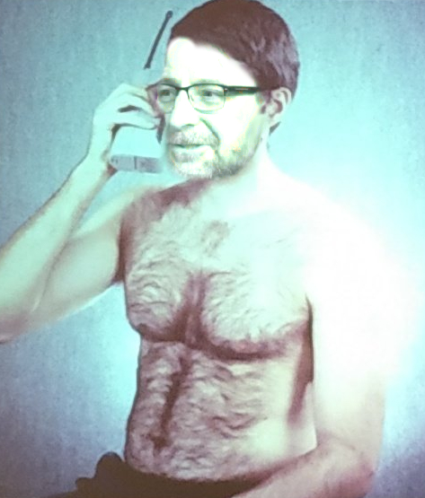
Erratum
Yo Walter, not sure
about
that
meme
Notes:
Please invest some time to reconsider your session: what is it that audience can get out of it? Try and be as precise as you can. If you are showing solutions, then focus on “how to”. If you present about a general technology, you’ll want to stick to “Be able to” or “Understand why/how”.

Slide 11
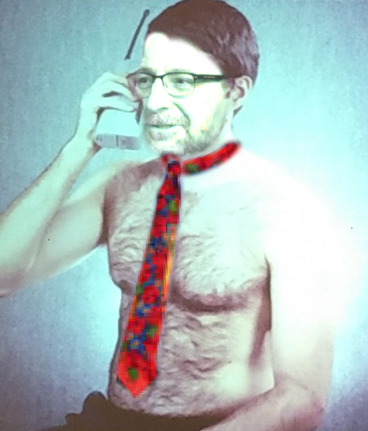
Erratum - Fix
Thanks Walter,
this is
much
better
Notes:
Please invest some time to reconsider your session: what is it that audience can get out of it? Try and be as precise as you can. If you are showing solutions, then focus on “how to”. If you present about a general technology, you’ll want to stick to “Be able to” or “Understand why/how”.

Slide 12
This Session
50% Passwords & Security Awareness
Understand how bad habits can help attackers
50% PowerShell & Tool Making
See how a little PowerShell can do a lot
Notes:
Please invest some time to reconsider your session: what is it that audience can get out of it? Try and be as precise as you can. If you are showing solutions, then focus on “how to”. If you present about a general technology, you’ll want to stick to “Be able to” or “Understand why/how”.

Slide 13
Agenda
Intro: Identity is the new Perimeter
Demos & Code:
RememberMe – Browser
RememberMe – Tool
PWDList
That little text file…
Invoke-KeeClip
Outro: What NOT to conclude & Take-Aways
Notes:
Psconf.eu is about demos and code. Try and minimize use of text slides

Slide 14
Before we start
I have a
Good News
and a
Bad News…
Notes:
Psconf.eu is about demos and code. Try and minimize use of text slides

Slide 15
Bad News
GrumpyCat is dead…
Notes:
Psconf.eu is about demos and code. Try and minimize use of text slides

Slide 16
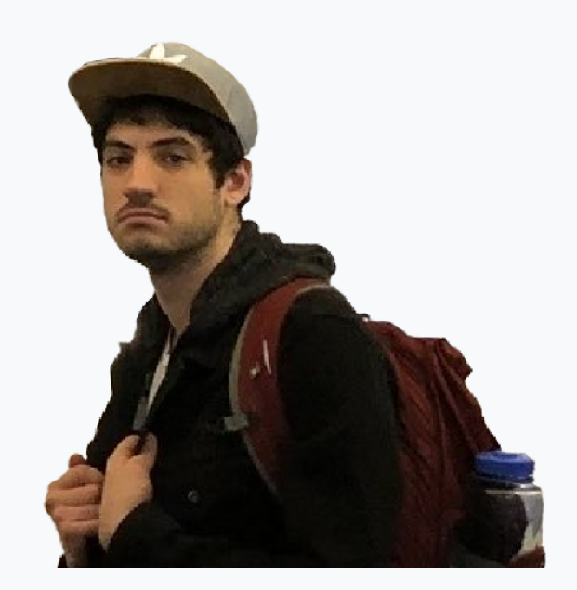
Good News
SadJoey is still alive
Notes:
Psconf.eu is about demos and code. Try and minimize use of text slides

Slide 17
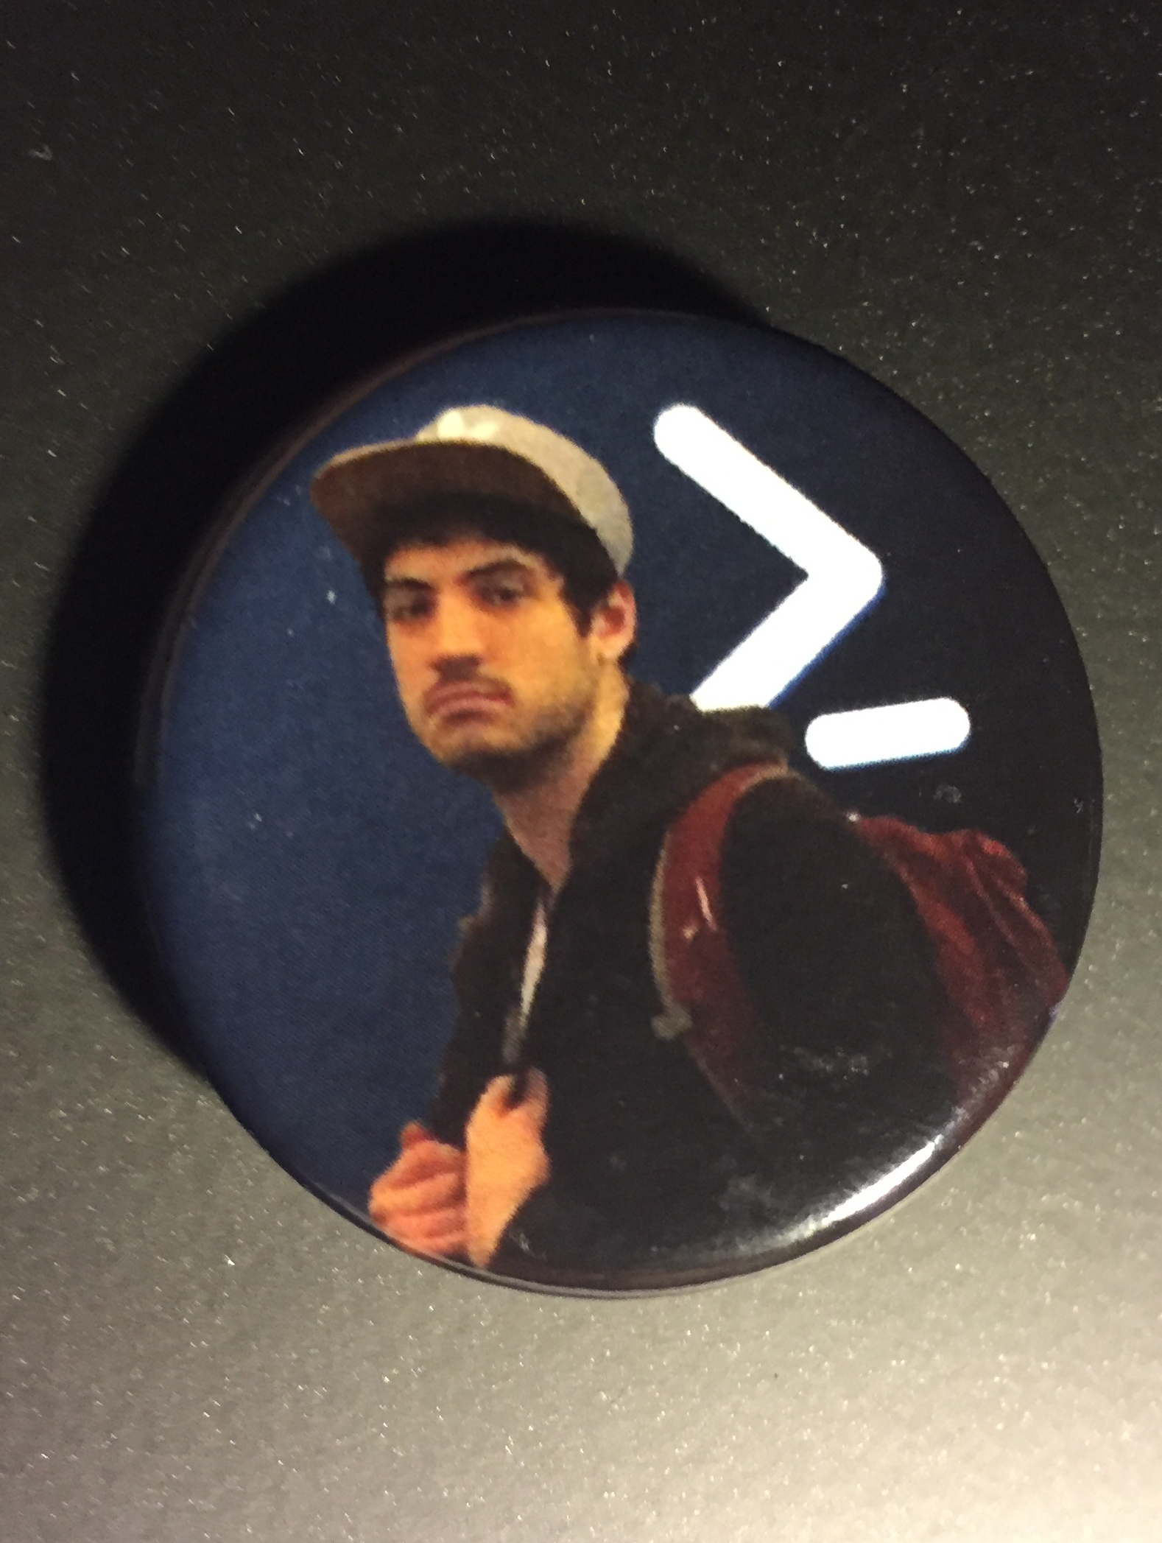
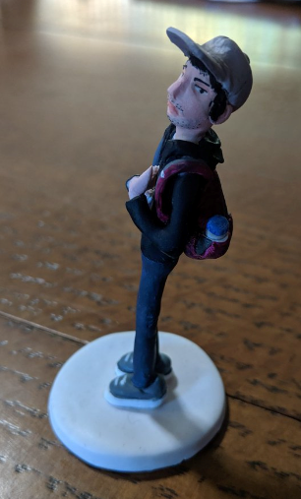
Good News
How cool is that !?!
Notes:
Psconf.eu is about demos and code. Try and minimize use of text slides

Slide 18
Show me all your Passwords
Walter Legowski
Notes:
This is your opening. Now the stage is yours!

Slide 19
Intro
Identity is the new Perimeter
Notes:
Psconf.eu is about demos and code. Try and minimize use of text slides

Slide 20
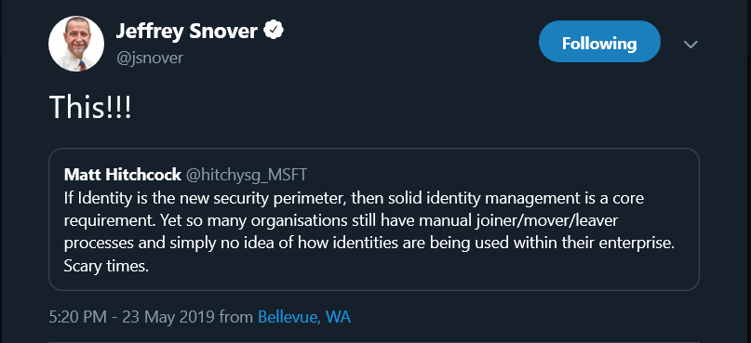
Intro
Notes:
Psconf.eu is about demos and code. Try and minimize use of text slides

Slide 21
Intro
Notes:
Psconf.eu is about demos and code. Try and minimize use of text slides

Slide 22









Attacker kill chain
<- Post-Exploitation --->
External
Recon
Delivery
Exploit
Internal
Recon
Lateral
Movement
PrivEsc
Persistence
Data
Collection
Exfiltration
Perimeter
Notes:
Psconf.eu is about demos and code. Try and minimize use of text slides

Slide 23
Raise your hand…
… if you use Email
Notes:
Psconf.eu is about demos and code. Try and minimize use of text slides

Slide 24
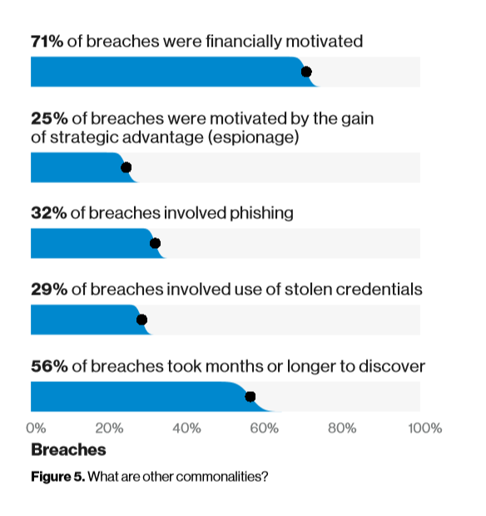
Scary stuff…
32% of breaches involved phishing
BDIR 2019
Notes:
Psconf.eu is about demos and code. Try and minimize use of text slides

Slide 25
But it’s OK…
We all had a Security Awareness
Training
[30 slides + 5 Qs = Compliance]
Notes:
Psconf.eu is about demos and code. Try and minimize use of text slides

Slide 26
Raise your hand…
…if you use Passwords
Notes:
Psconf.eu is about demos and code. Try and minimize use of text slides

Slide 27
Scary stuff…
29% of breaches involved stolen Creds
BDIR 2019
Notes:
Psconf.eu is about demos and code. Try and minimize use of text slides

Slide 28
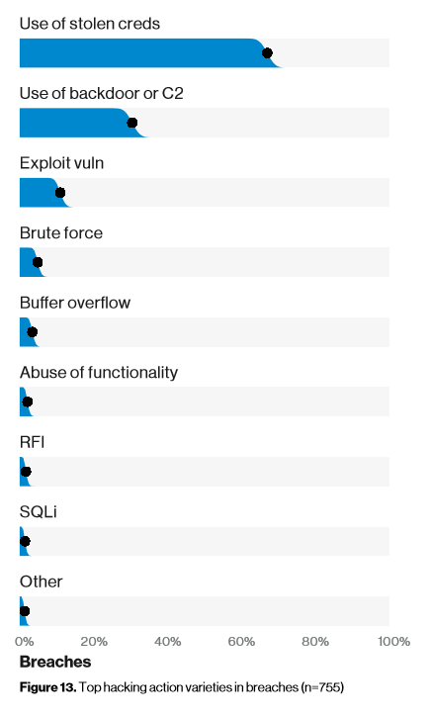
Scary stuff…
Use of Stolen Creds
is most used Hacking Technique
Src: BDIR
BDIR 2019
Notes:
Psconf.eu is about demos and code. Try and minimize use of text slides

Slide 29
Scary stuff…
https://www.informationisbeautiful.net/visualizations/worlds-biggest-data-breaches-hacks/
Notes:
Psconf.eu is about demos and code. Try and minimize use of text slides

Slide 30
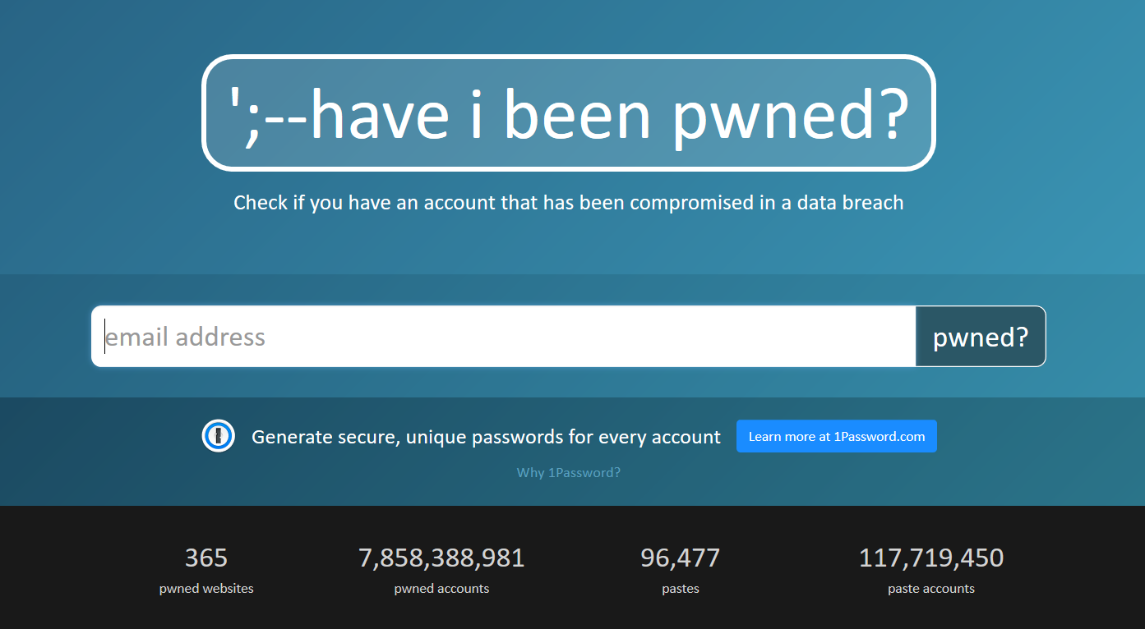
HaveIBeenPwned…
Notes:
Psconf.eu is about demos and code. Try and minimize use of text slides

Slide 31
Attacker kill chain
<- Post-Exploitation --->
External
Recon
Delivery
Exploit
Internal
Recon
Lateral
Movement
PrivEsc
Persistence
Data
Collection
Exfiltration
Perimeter
Notes:
Psconf.eu is about demos and code. Try and minimize use of text slides

Slide 32
Remember Me - Browser

Slide 33
RememberMe Browser - Fix
Use a Password Manager
Notes:
Psconf.eu is about demos and code. Try and minimize use of text slides

Slide 34
Remember Me - Tool

Slide 35
RememberMe Tool - Fix
Use a Password Manager
Notes:
Psconf.eu is about demos and code. Try and minimize use of text slides

Slide 36
Password lists

Slide 37
Guessable Passwords - Fix
Use Random Passwords
[Use a Password Manager]
Notes:
Psconf.eu is about demos and code. Try and minimize use of text slides

Slide 38
That little text file…

Slide 39
That little text file - Fix
Use a Password Manager
Notes:
Psconf.eu is about demos and code. Try and minimize use of text slides

Slide 40
KeeClip

Slide 41
KeeClip - Fix
Use a Password Manager
Notes:
Psconf.eu is about demos and code. Try and minimize use of text slides

Slide 42
Conclusions
Notes:
Psconf.eu is about demos and code. Try and minimize use of text slides

Slide 43

Conclusion
CAN’T FORGET YOUR PASSWORDS
IF YOU ALWAYS USE “PASSWORD”
Notes:
Sum up your key messages

Slide 44
Conclusion
Password managers are pointless…
Notes:
Sum up your key messages

Slide 45
Conclusion
Password managers are pointless… NOT!
Avoid Password reuse
Avoid weak Passwords
Avoid guessable Passwords (pattern)
> Never designed to protect against post-exploitation…
https://www.sans.org/security-awareness-training/blog/2019-verizon-dbir-key-findings-security-awareness-officers
Notes:
Sum up your key messages

Slide 46
Conclusion
PowerShell is Evil…
Notes:
Sum up your key messages

Slide 47
Conclusion
PowerShell is Evil… NOT!
If your adversary is ‘‘only’’ mature enough to be using PowerShell, you are in luck…
- How would you catch him if he was using Python, Bash or <LanguageGoesHere>?
Notes:
Sum up your key messages

Slide 48
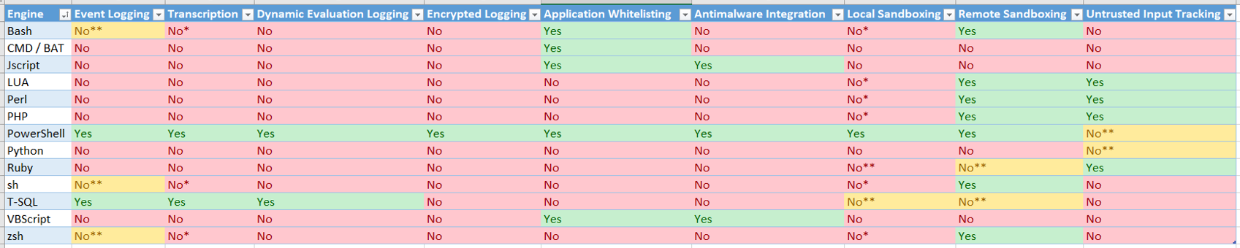
Conclusion
PowerShell is Evil… NOT!
https://devblogs.microsoft.com/powershell/a-comparison-of-shell-and-scripting-language-security/
Notes:
Sum up your key messages

Slide 49
Conclusion
PowerShell is Evil… NOT!
https://devblogs.microsoft.com/powershell/a-comparison-of-shell-and-scripting-language-security/
Notes:
Sum up your key messages

Slide 50
More Info
DBIR
https://enterprise.verizon.com/resources/reports/dbir/
https://www.sans.org/security-awareness-training/blog/2019-verizon-dbir-key-findings-security-awareness-officers
Tools
https://github.com/SadProcessor/SomeStuff
https://github.com/EmpireProject/Empire/tree/master/data/module_source
PowerShell Security
https://blogs.msdn.microsoft.com/powershell/2015/06/09/powershell-the-blue-team/
https://devblogs.microsoft.com/powershell/a-comparison-of-shell-and-scripting-language-security/
Notes:
Sum up your key messages

Slide 51
Notes:
[REQUIRED SLIDE]
Make sure you provide all materials that audience needs to reproduce your demos.
Either upload them as a PowerShell module to www.powershellgallery.com (preferred for reusable functions)
Or, upload them to our github repository (ask the girls at the info desk to provide you with access)
Or, upload them to your own github repository
Please make sure all materials are available by the time your presentation starts, or at minimum upload them right after your presentation

Slide 52
Notes:
[REQUIRED SLIDE]
If you sticked to your timing, you now have 15 min left for Q&A. If you missed your timing, you will have to leave the room when your slot is over. In this case, invite your audience to the coffee break and offer to cover questions there.
IN ANY CASE please point your audience to the conference app and the session voting. By the time the conference opens, the eventraft app *should* have the option to vote on sessions.
Please MAKE SURE you leave your room when your slot is over. The next speaker would like to set him/herself up and get everything up and running.

Slide 53
Thank You

